Slide 1
Enrollment System
both, Betse, Vitek, Ivan

Slide 2
Core Features
Enrollment
Unenrollment
Enrollment History
Class Material
Enrollment Accessibility

Slide 3
Feature: Enrollment
User story: As a student, I want to easily enroll in courses through the enrollment system so that I can secure my spot in the required classes and track my enrollment status.
The user accesses the Student Information System (SIS) main page and clicks on the enrollment feature.
The SIS retrieves the user’s profile data and sends it to the enrollment system.
The system displays the list of available courses on the user’s dashboard.
The system show the courses to user dashboard.
When the user selects a course to enroll in, the system performs a validation check based on the type of enrollment:
Enroll in lecture:
The system checks the course's current capacity.
If space is available, the user is successfully enrolled in the lecture, and the system stores the enrollment data in the database.
If the course is full, the user is placed on a waiting list, and the system records this status in the database.
Enroll in practical:
The system verifies the practical course's capacity.
If space are available, the user is enrolled in the practical, and the system logs the enrollment details in the database.
If no space are available, the user is added to the waiting list for that practical, with all relevant data stored in the database.
System update the dashboard in enrollment for user to view the most recent enrollment status and waiting list information.

Slide 4
Feature: Unenrollment
User story: As a student, I want to be able to unenroll a course I've enrolled in so that I can free up space in my schedule or make changes to my course plan.
The student accesses the course enrollment dashboard.
The system retrieves student’s enrolled courses.
The system retrieves the list of courses the student is currently enrolled in and displays them on the dashboard.
The student selects the course they want to drop.
The system checks the course's drop policy:
Within Allowed Drop Period:
If the course is within the allowed drop period, the system allows the student to proceed with the drop.
Past Drop Deadline:
If the course is past the drop deadline, the system displays a warning or blocks the unenrollment based on institutional rules.
The student confirms the drop action.
The student confirms the action to drop the course.
The system logs the confirmation, recording the student’s ID, the course ID, the timestamp, and whether the action was within the allowed period or after a warning.
The system updates enrollment data.
The system updates the database by removing the student’s enrollment from the selected course.
The system logs the successful unenrollment, capturing the student’s ID, course details, and the timestamp of the action.
The student’s dashboard is updated to reflect the changes.
Manage Waiting List
If the dropped course had a waiting list, the system automatically enrolls the next student in line and notifies them of the change.
The system logs the automatic enrollment, recording the newly enrolled student’s ID, course details, and when the notification was sent.

Slide 5
Feature: Enrollmen-History
As a student, I want to view a history of all my past and current course enrollments so I can keep track of my academic progress.
The student navigates to the "Enrollment History" feature from the main dashboard.
The system retrieves the student’s past and current enrollment data from the database.
The system displays the courses the student has enrolled in, dropped, or completed, along with details like:
Course name and code
Semester and year
Enrollment status (enrolled, dropped, completed)
Grades (if applicable)
The student can filter or sort the list by semester, year, or course status.
The student can export their enrollment history as a PDF for record-keeping or academic advising.

Slide 6
Feature: Class-Material
As a teacher, I want to share class material with the students.
The user accesses the Student Information System (SIS) main page and clicks on the enrollment feature.
The SIS retrieves the user’s profile data and sends it to the enrollment system.
The system displays the list of available courses on the user’s dashboard.
The system show the courses he teaches in in 'Tought classes' tab.
User selects the course.
Modifying course information:
Teacher clicks change course description. If the character limit is not exceeded description is updated.
Teacher clicks attach file. If the maximum number of attached files and maximum total file size for given course is not exceeded file is attached.
Teacher clicks remove selected file.

Slide 7
Feature: Class-Material
As a student I want to access said material for my education and studying purposes.
The user accesses the Student Information System (SIS) main page and clicks on the enrollment feature.
The SIS retrieves the user’s profile data and sends it to the enrollment system.
The system displays the list of available courses on the user’s dashboard.
The system show the courses he enrolled in in 'Enrolled in' tab.
User selects the course.
Viewing material
Student can see the course description.
Student can download attached files by clicking on them.

Slide 8
Feature: Enrollment Management
As an Study Officer, I would like to have the ability to open and close enrollment access for any course.
The user accesses the Student Information System (SIS) main page and clicks on the enrollment feature.
The SIS retrieves the user’s profile data and displays the list of managed courses dashboard.
User selects the course button.
To open course enrollment:
The user submits the course to the public.
To close course enrollment:
The user selects the Close Enrollment button.

Slide 9
Responsibilities
Data Retrieval Responsibilities
Retrieve user profile and course data. (Features: Enrollment, Class Material, Enroll Accessibility, Unenroll Course, Enrollment History)
2. Course Data Management Responsibilities
Manage course filtering, access, and availability. (Features: Enrollment, Class Material, Enroll Accessibility)
3. Validation Responsibilities
Validate course capacity, prerequisites, and drop policies. (Features: Enrollment, Unenroll Course)
4. Data Storage Responsibilities
Record enrollment actions and maintain accurate waitlists and history. (Features: Enrollment, Unenroll Course, Enrollment History)
5. Dashboard Update Responsibilities
Dynamically update course enrollment and status views. (Features: Enrollment, Unenroll Course, Enrollment History)
6. User Notification Responsibilities
Notify students of enrollment changes and updates. (Features: Enrollment, Unenroll Course, Class Material, Enroll Accessibility)
7. Error Handling and Troubleshooting Responsibilities
Handle errors and log issues for troubleshooting. (Features: Enrollment, Class Material, Unenroll Course)

Slide 10
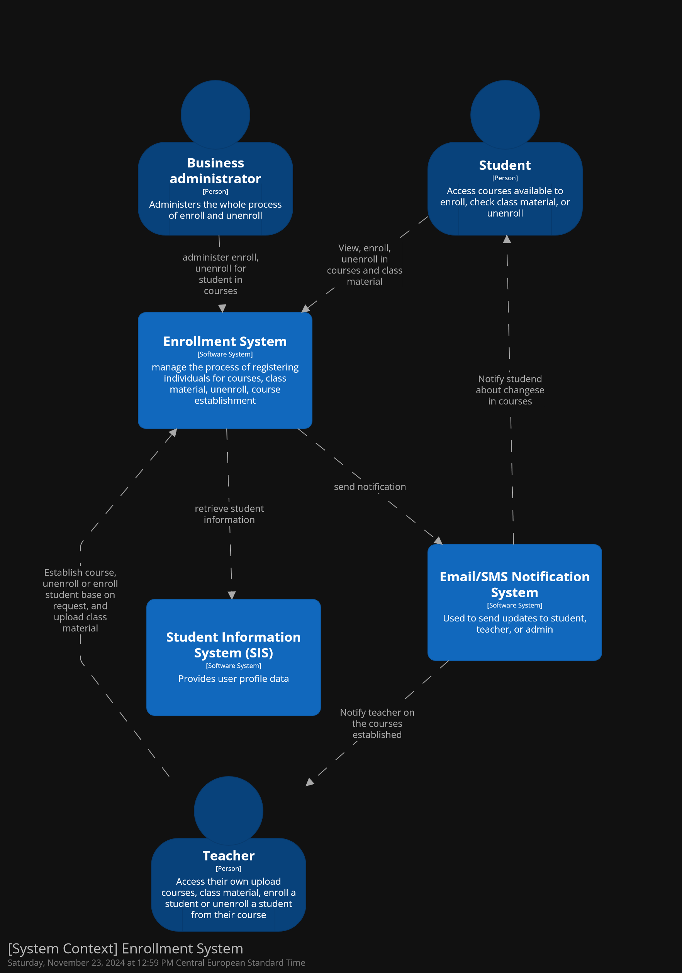
C4 Model L1

Slide 11
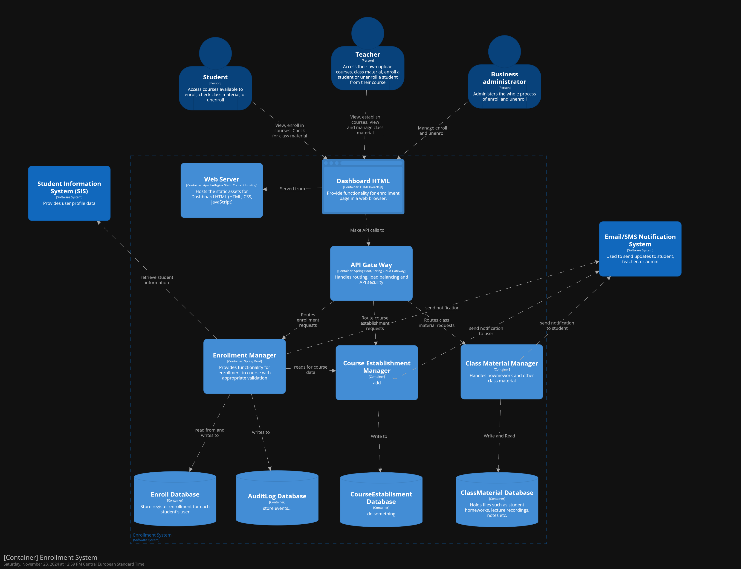
C4 Model L2

Slide 12
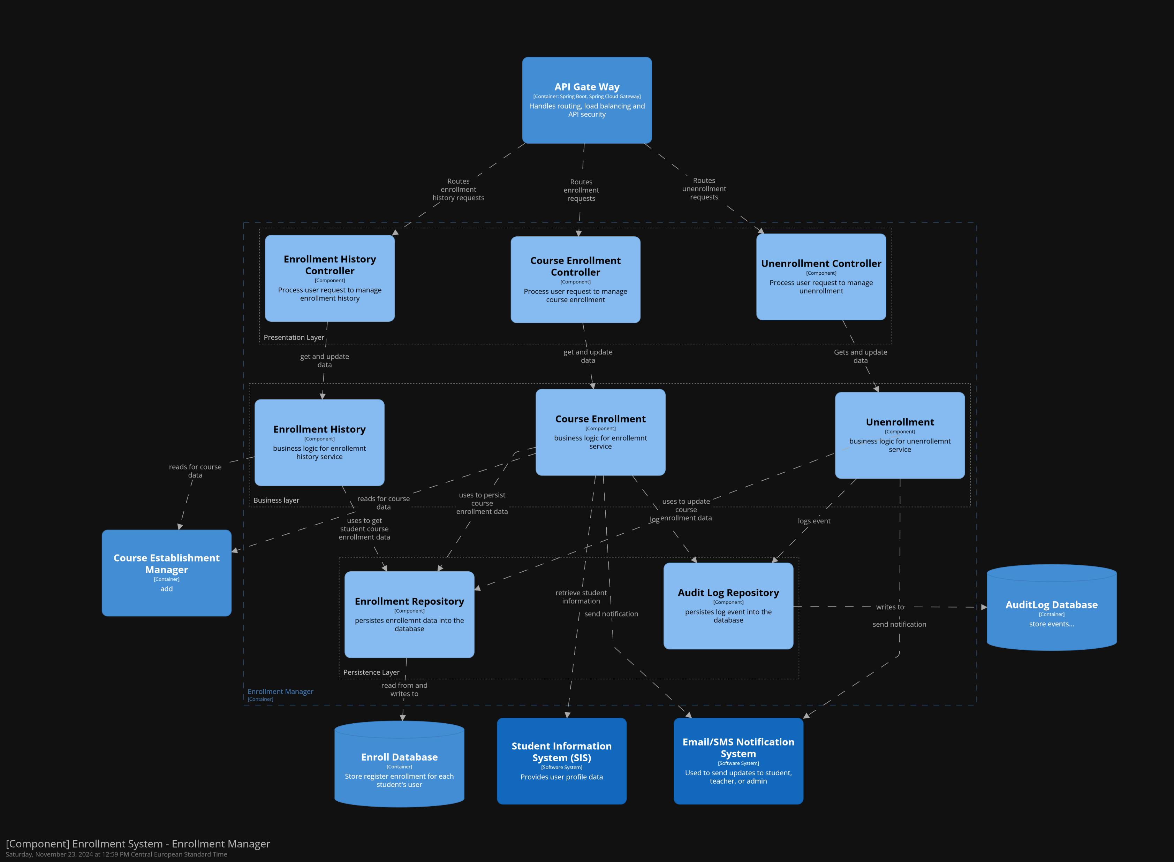
C4 Model L3: Enrollment Manager Container

Slide 13
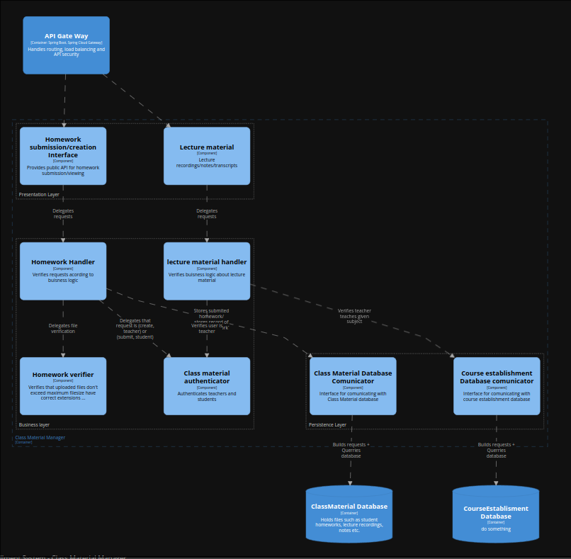
C4 Model L3: Class Material Manager Container

Slide 14
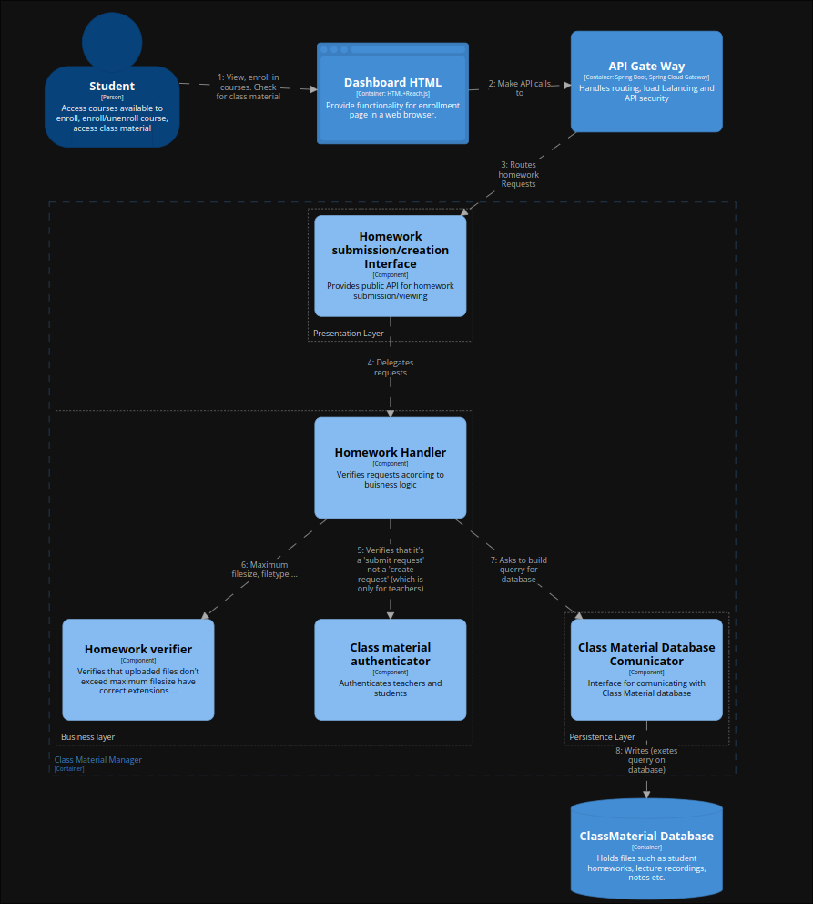
C4 Model L3: Class Material Homework submission

Slide 15
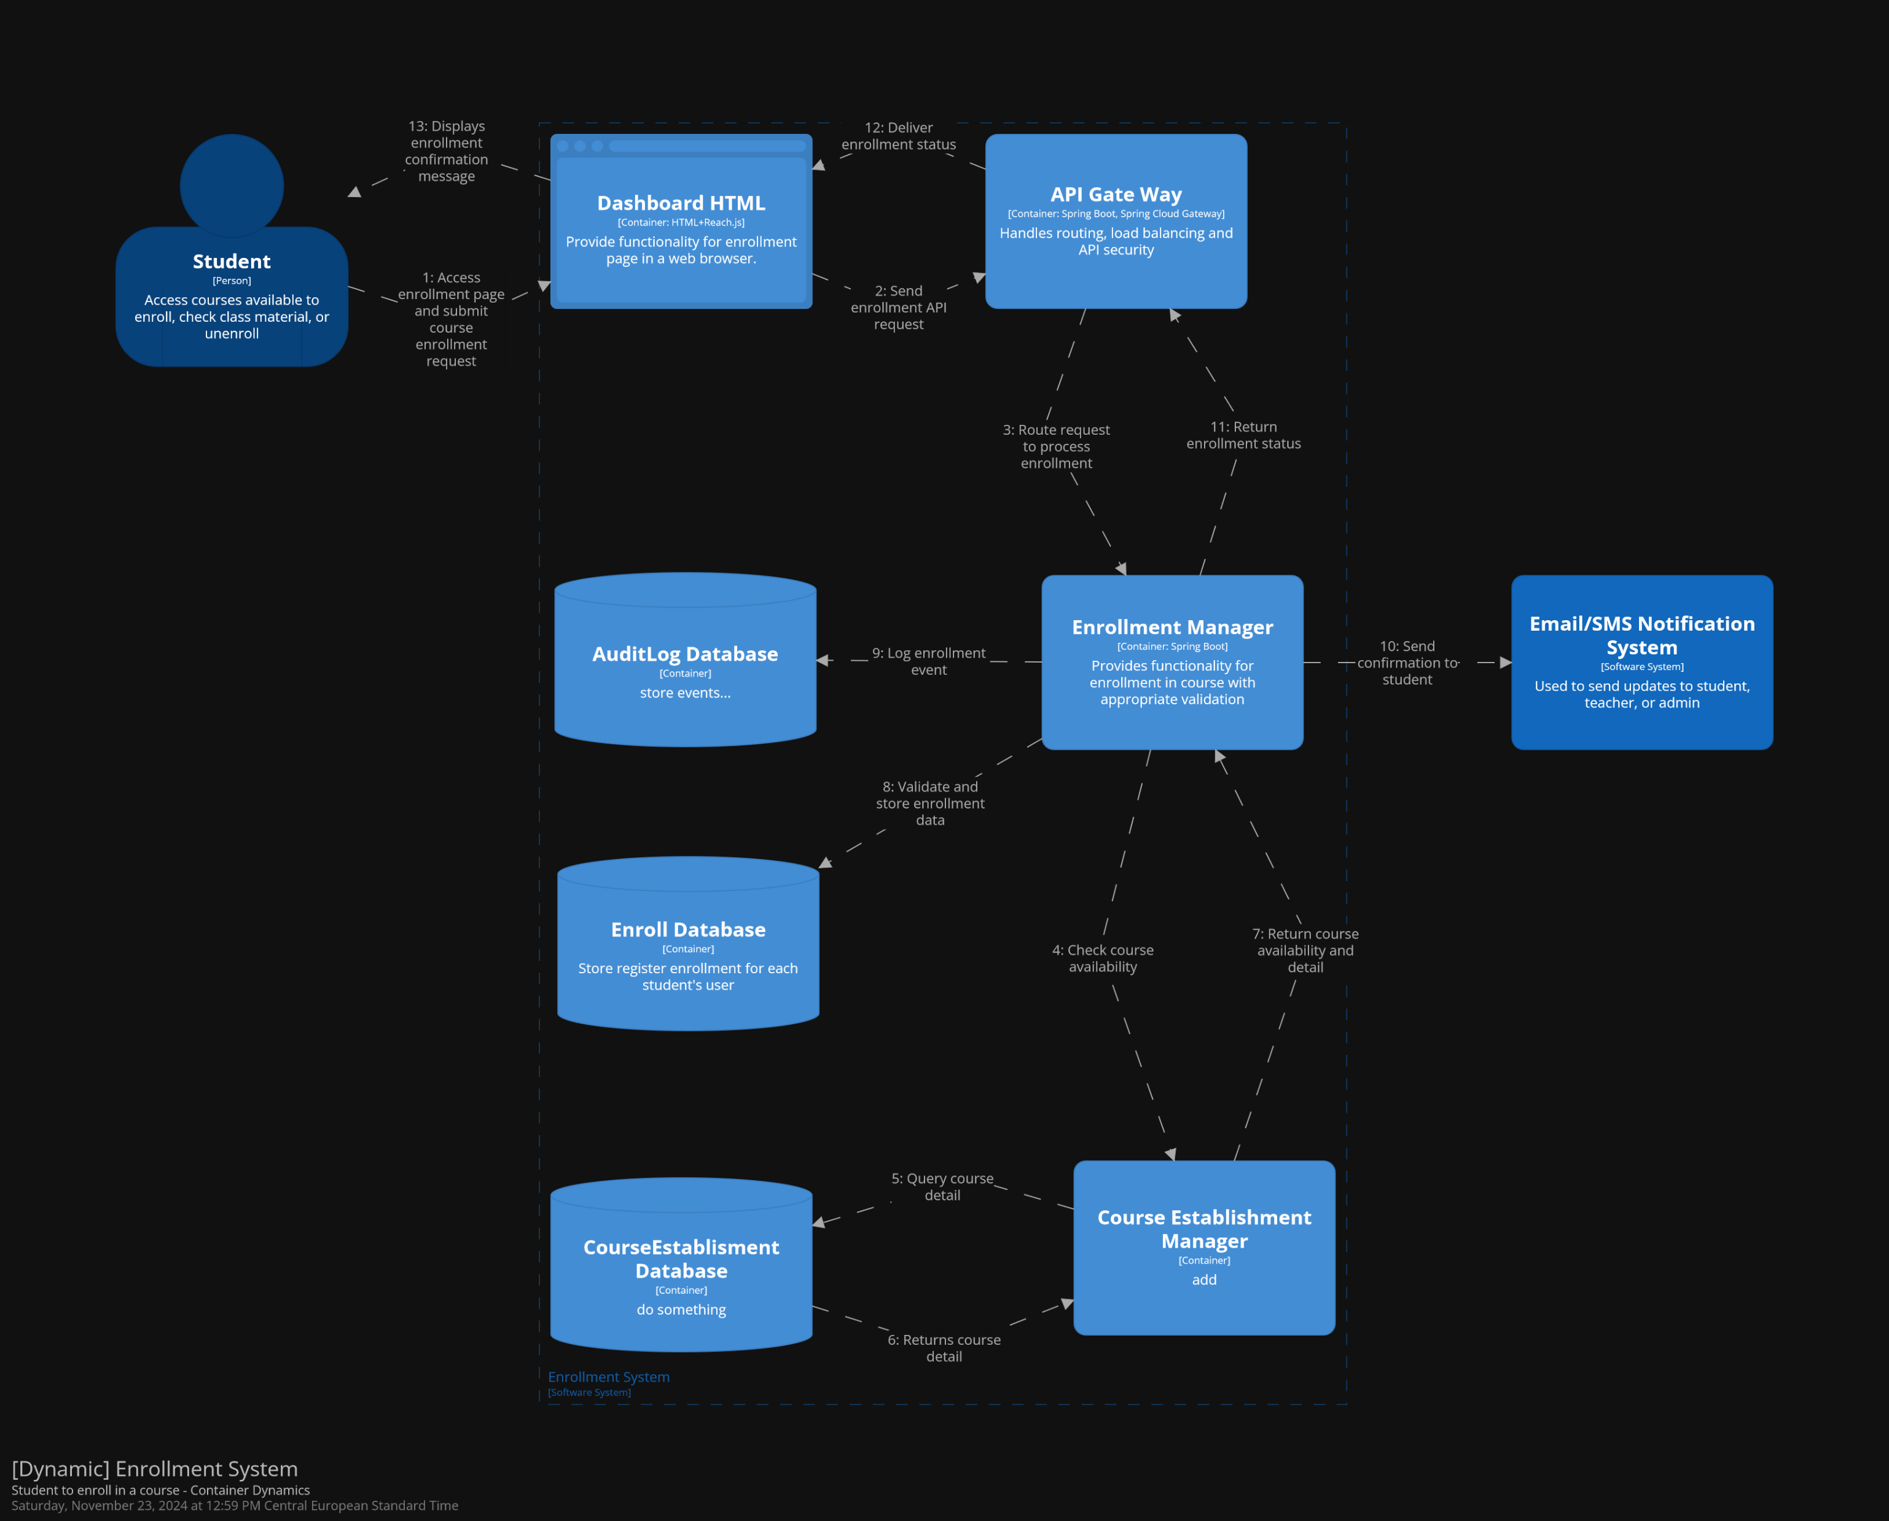
C4 Model L3: Enrollment System Dynamic Diagram

Slide 16
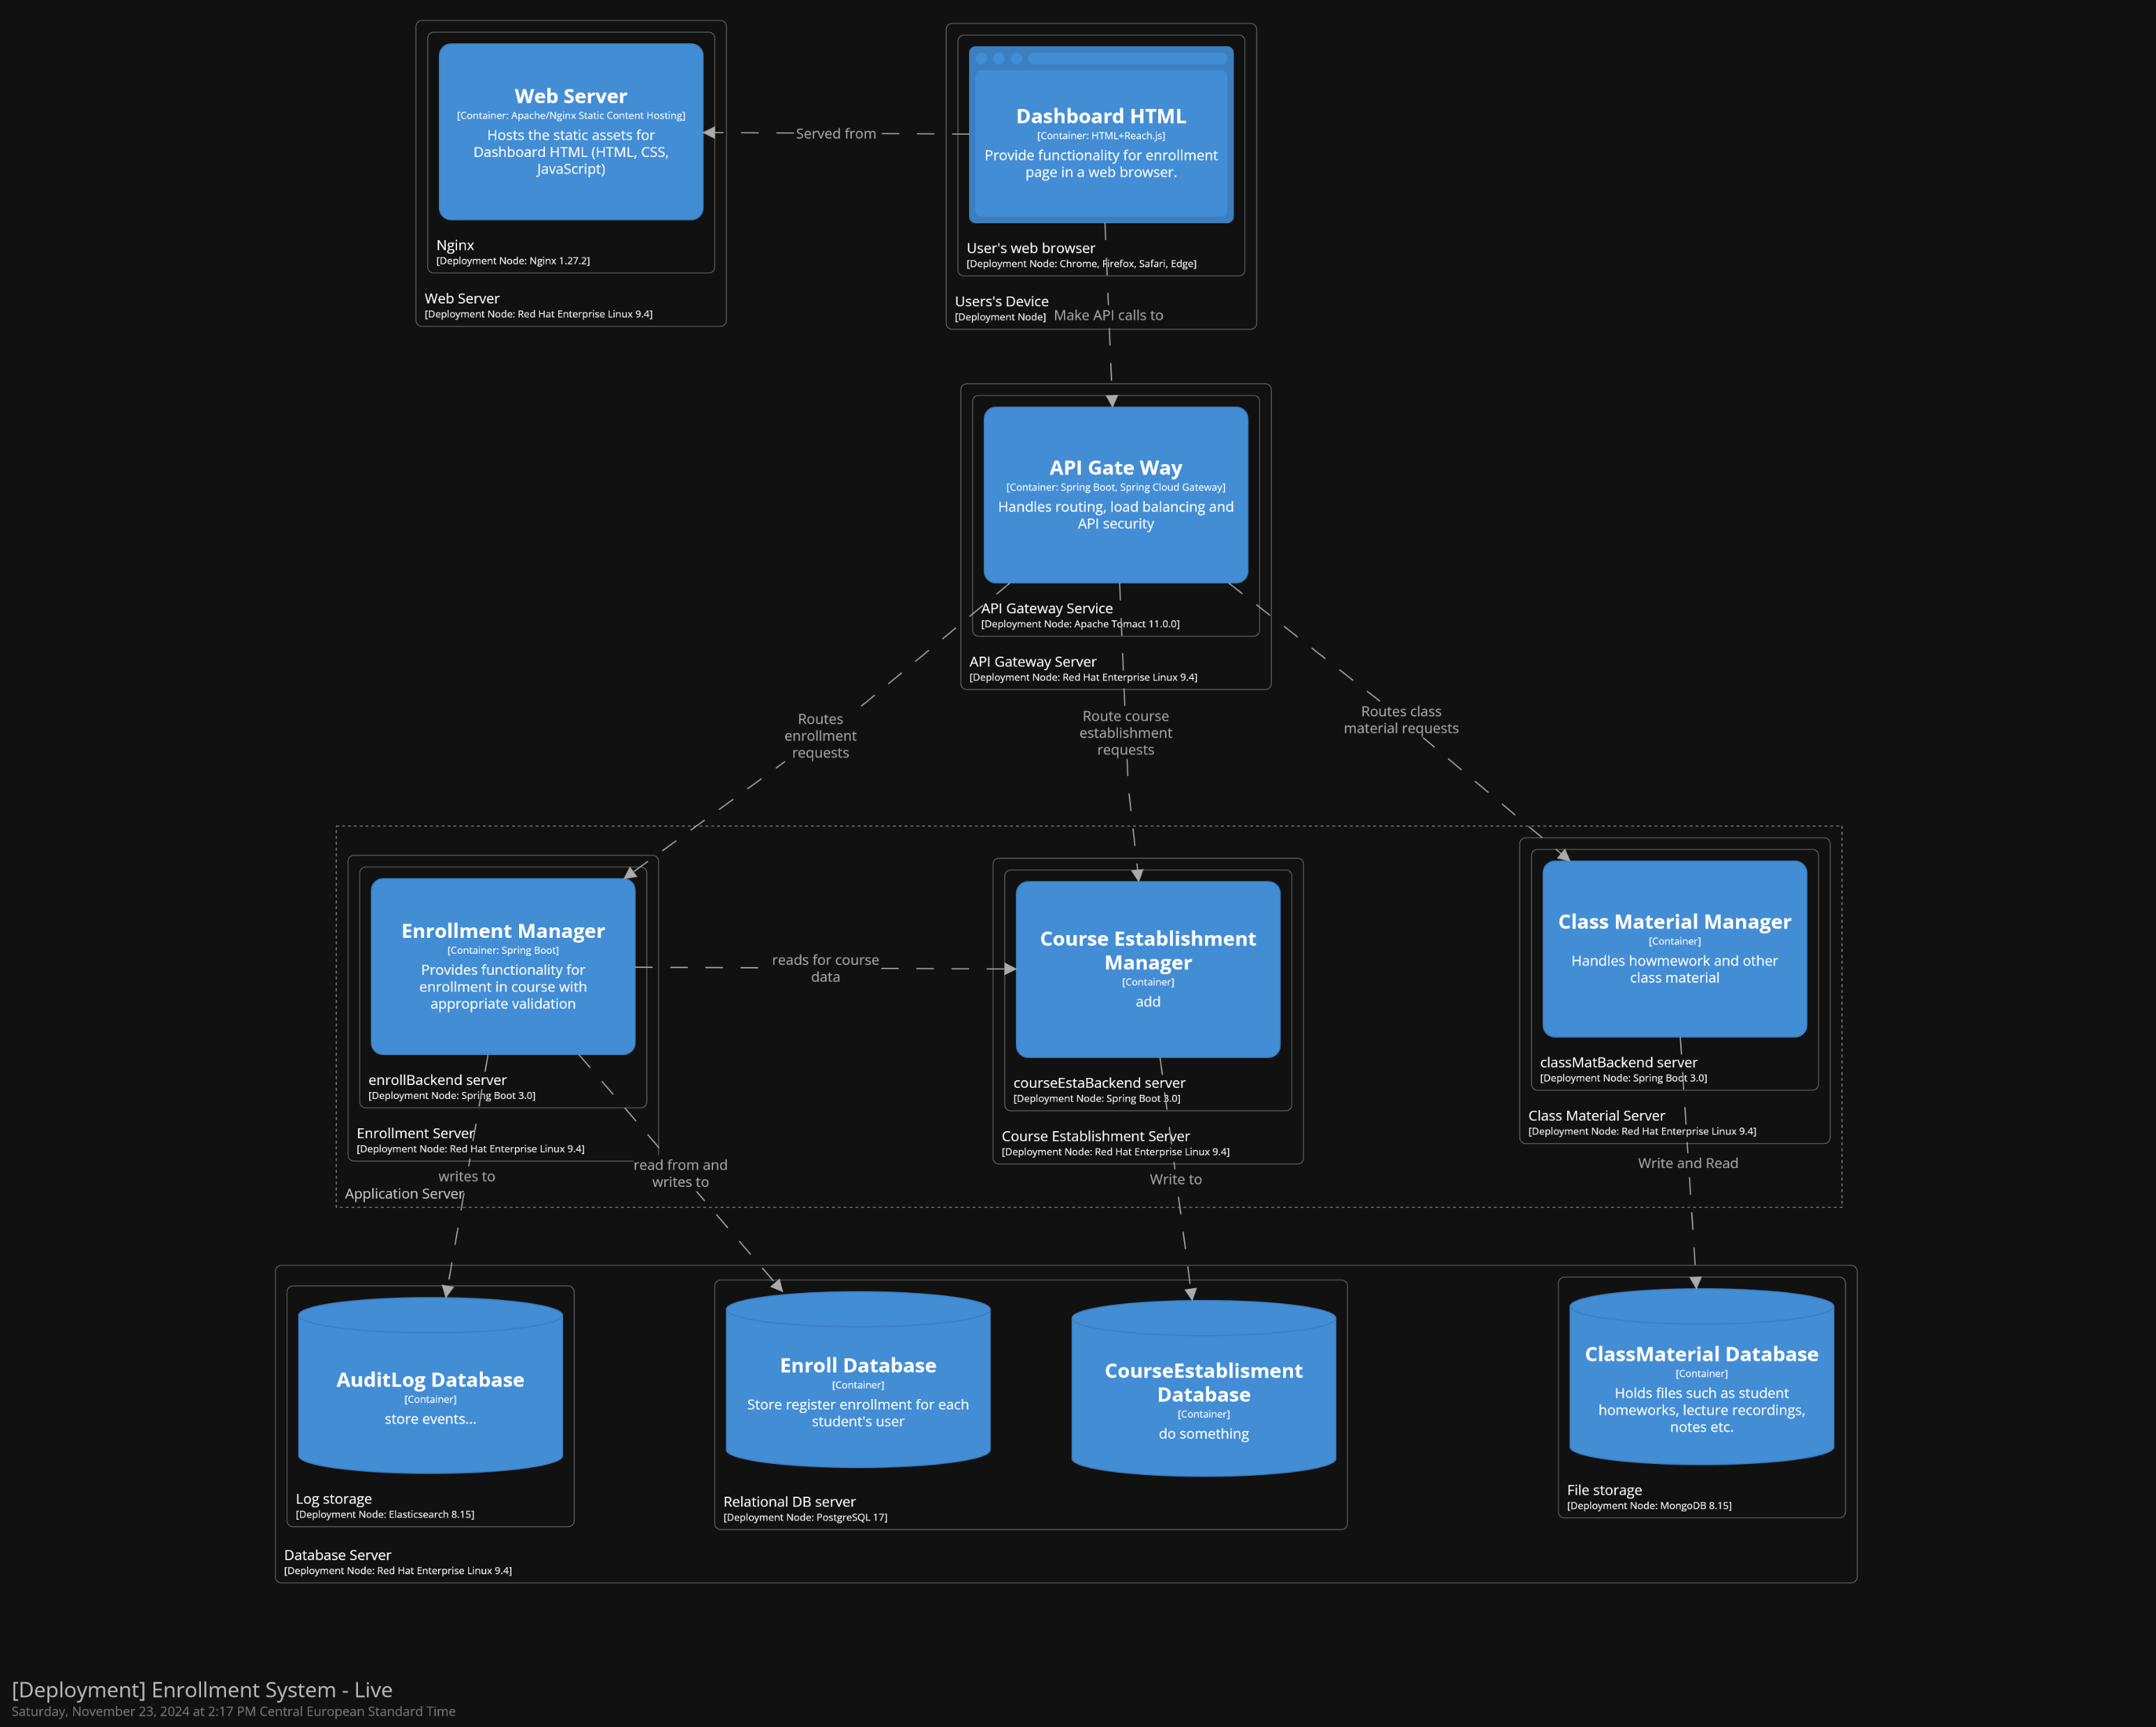
Deployment Diagram (Live)

Slide 17
Thank you

